Slide 1

Practical game theory for explainable machine learning
Scott Lundberg
Microsoft Research

Slide 2










Why was I denied?
chance John will have repayment problems
model
22%
No loan
What is our
financial risk?
How do I
debug?
John, a bank customer
Notes:
We'll start with a simple motivational example. This is John, a typical bank customer. Like many consumers today, when he applies for a loan, information about him is sent through a predictive model XX.
This model is designed to calculate the risk that John will have repayment problems, XX which, unfortunately for John, is 55%. And because his risk is high, the bank declines his loan application XX.
A natural first question John has XX is “Why?” The bank XX also want to know why, because these are key business decisions. But unfortunately for the data scientist that built this model XX, she used a complex model and so these questions are hard to answer XX …. XX

Slide 3

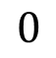
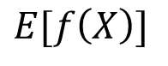
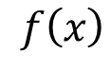
Base rate
Prediction for John
16%
22%
How did we get here?
Notes:
To see, let’s return to John and answer why his loan application was denied. To explain his denial it is important to start with the base rate of loan repayment problems XX, denoted here by the expected value of the model’s output.
To explain John's risk XX, we need to explain how we got from the base rate XX, to his risk of 55%. XX

Slide 4
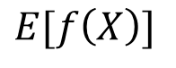
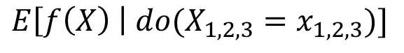
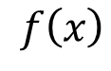
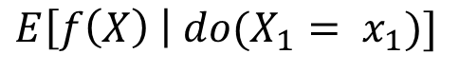
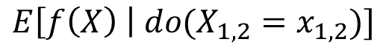
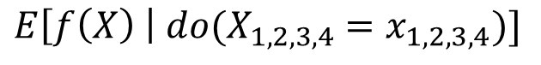
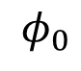
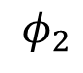
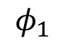
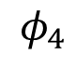
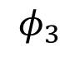
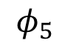
16%
18.2%
18.5%
21%
22%
22.5%
*
Base rate
DTI = 30
Income not verified
Delinquent 10 months ago
No recent account openings
*Janzing et al. 2019
46 years of credit history
Notes:
To see, let’s return to John and answer why his loan application was denied. To explain his denial it is important to start with the base rate of loan repayment problems XX, denoted here by the expected value of the model’s output.
To explain John's risk XX, we need to explain how we got from the base rate XX, to his risk of 55%. XX

Slide 5
The order matters!
16%
18.2%
18.5%
21%
22%
22.5%
*
Base rate
DTI = 30
Income not verified
Delinquent 10 months ago
No recent account openings
*Janzing et al. 2019
46 years of credit history
Notes:
To see, let’s return to John and answer why his loan application was denied. To explain his denial it is important to start with the base rate of loan repayment problems XX, denoted here by the expected value of the model’s output.
To explain John's risk XX, we need to explain how we got from the base rate XX, to his risk of 55%. XX

Slide 6

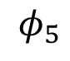
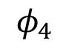
Lloyd Shapley
The order matters!
Nobel Prize in 2012
46 years of credit history
No recent account openings
Notes:
To see, let’s return to John and answer why his loan application was denied. To explain his denial it is important to start with the base rate of loan repayment problems XX, denoted here by the expected value of the model’s output.
To explain John's risk XX, we need to explain how we got from the base rate XX, to his risk of 55%. XX

Slide 7
Lloyd Shapley
Shapley values are the only credit allocation that satisfies four axioms:
Efficiency
Symmetry (or anonymity)
Dummy
Linearity (or monotonicity)
Nobel Prize in 2012
46 years of credit history
No recent account openings
Notes:
To see, let’s return to John and answer why his loan application was denied. To explain his denial it is important to start with the base rate of loan repayment problems XX, denoted here by the expected value of the model’s output.
To explain John's risk XX, we need to explain how we got from the base rate XX, to his risk of 55%. XX

Slide 8
Shapley values result from averaging over all N! possible orderings.
(NP-hard)
Notes:
To see, let’s return to John and answer why his loan application was denied. To explain his denial it is important to start with the base rate of loan repayment problems XX, denoted here by the expected value of the model’s output.
To explain John's risk XX, we need to explain how we got from the base rate XX, to his risk of 55%. XX

Slide 9
Intuitions from applications to linear models

Slide 10
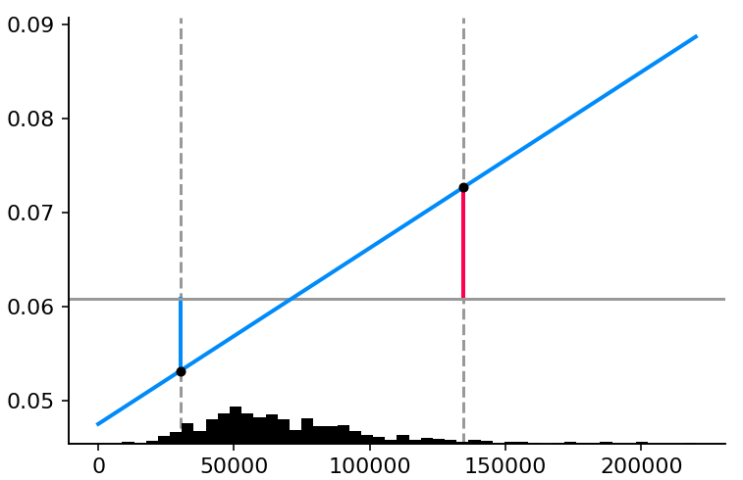
sklearn.linear_model.LinearRegression()
Partial dependence plot
Model output
ɸ_{i} (SHAP value)
= β_{i} * (x_{i} – E[x_{i}])
x_{i}
(feature value)
Notes:
Make title shorter

Slide 11
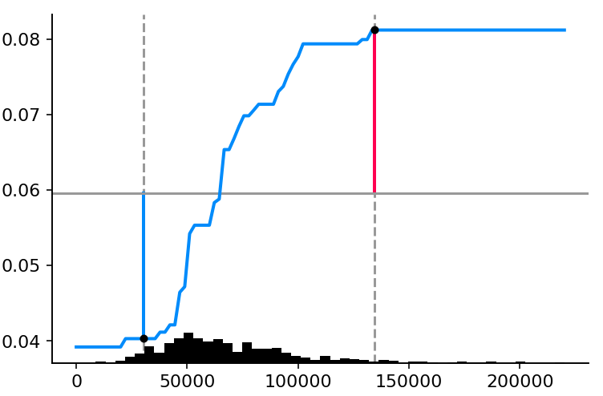
xgboost.XGBRegressor(max_depth=1)
Partial dependence plot
ɸ_{i} (SHAP value)
= f_{i}(x_{i}) – E[f_{i}(x_{i})]
Model output
x_{i}
(feature value)
Notes:
Make title shorter

Slide 12
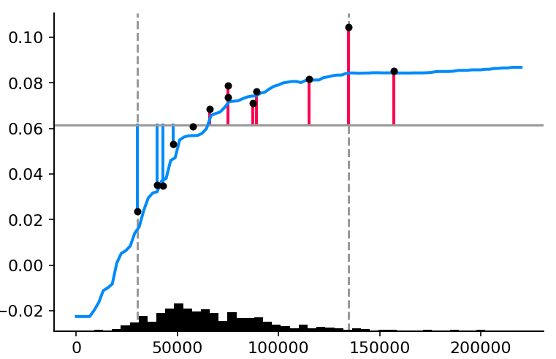
xgboost.XGBRegressor()
Partial dependence plot
ɸ_{i} (SHAP value)
Model output
x_{i}
(feature value)
Notes:
Make title shorter

Slide 13
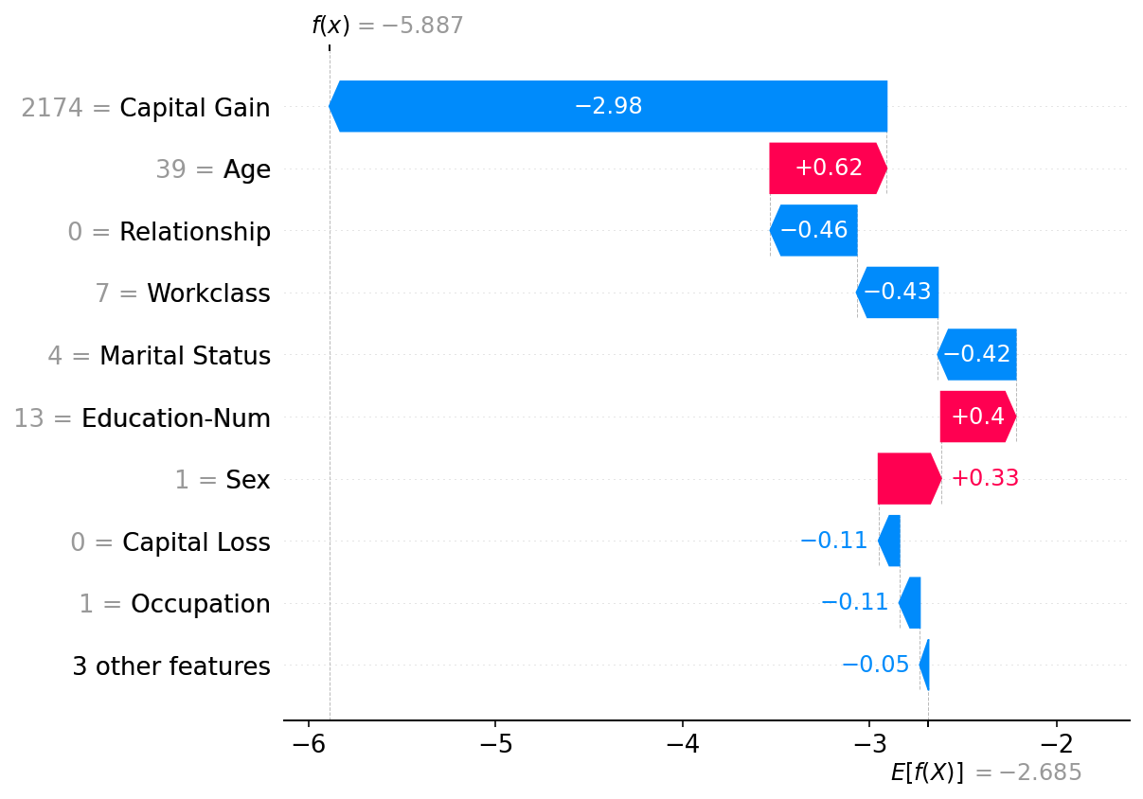
Example from a gradient boosting model
Notes:
We'll start with a simple motivational example. This is John, a typical bank customer. Like many consumers today, when he applies for a loan, information about him is sent through a predictive model XX.
This model is designed to calculate the risk that John will have repayment problems, XX which, unfortunately for John, is 55%. And because his risk is high, the bank declines his loan application XX.
A natural first question John has XX is “Why?” The bank XX also want to know why, because these are key business decisions. But unfortunately for the data scientist that built this model XX, she used a complex model and so these questions are hard to answer XX …. XX

Slide 14
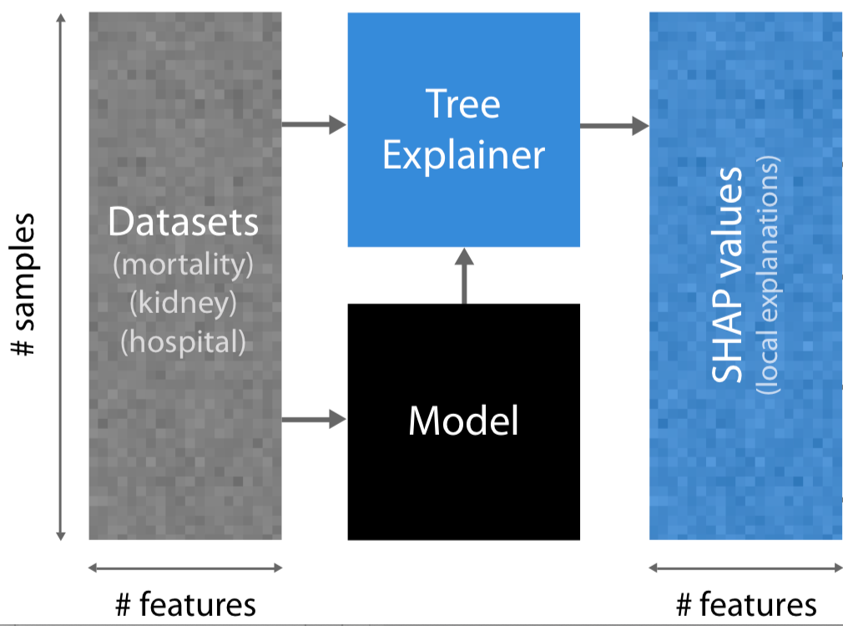
Representing global model structure with local feature importance values

Slide 15
The interpretability cost of model bias

Slide 16
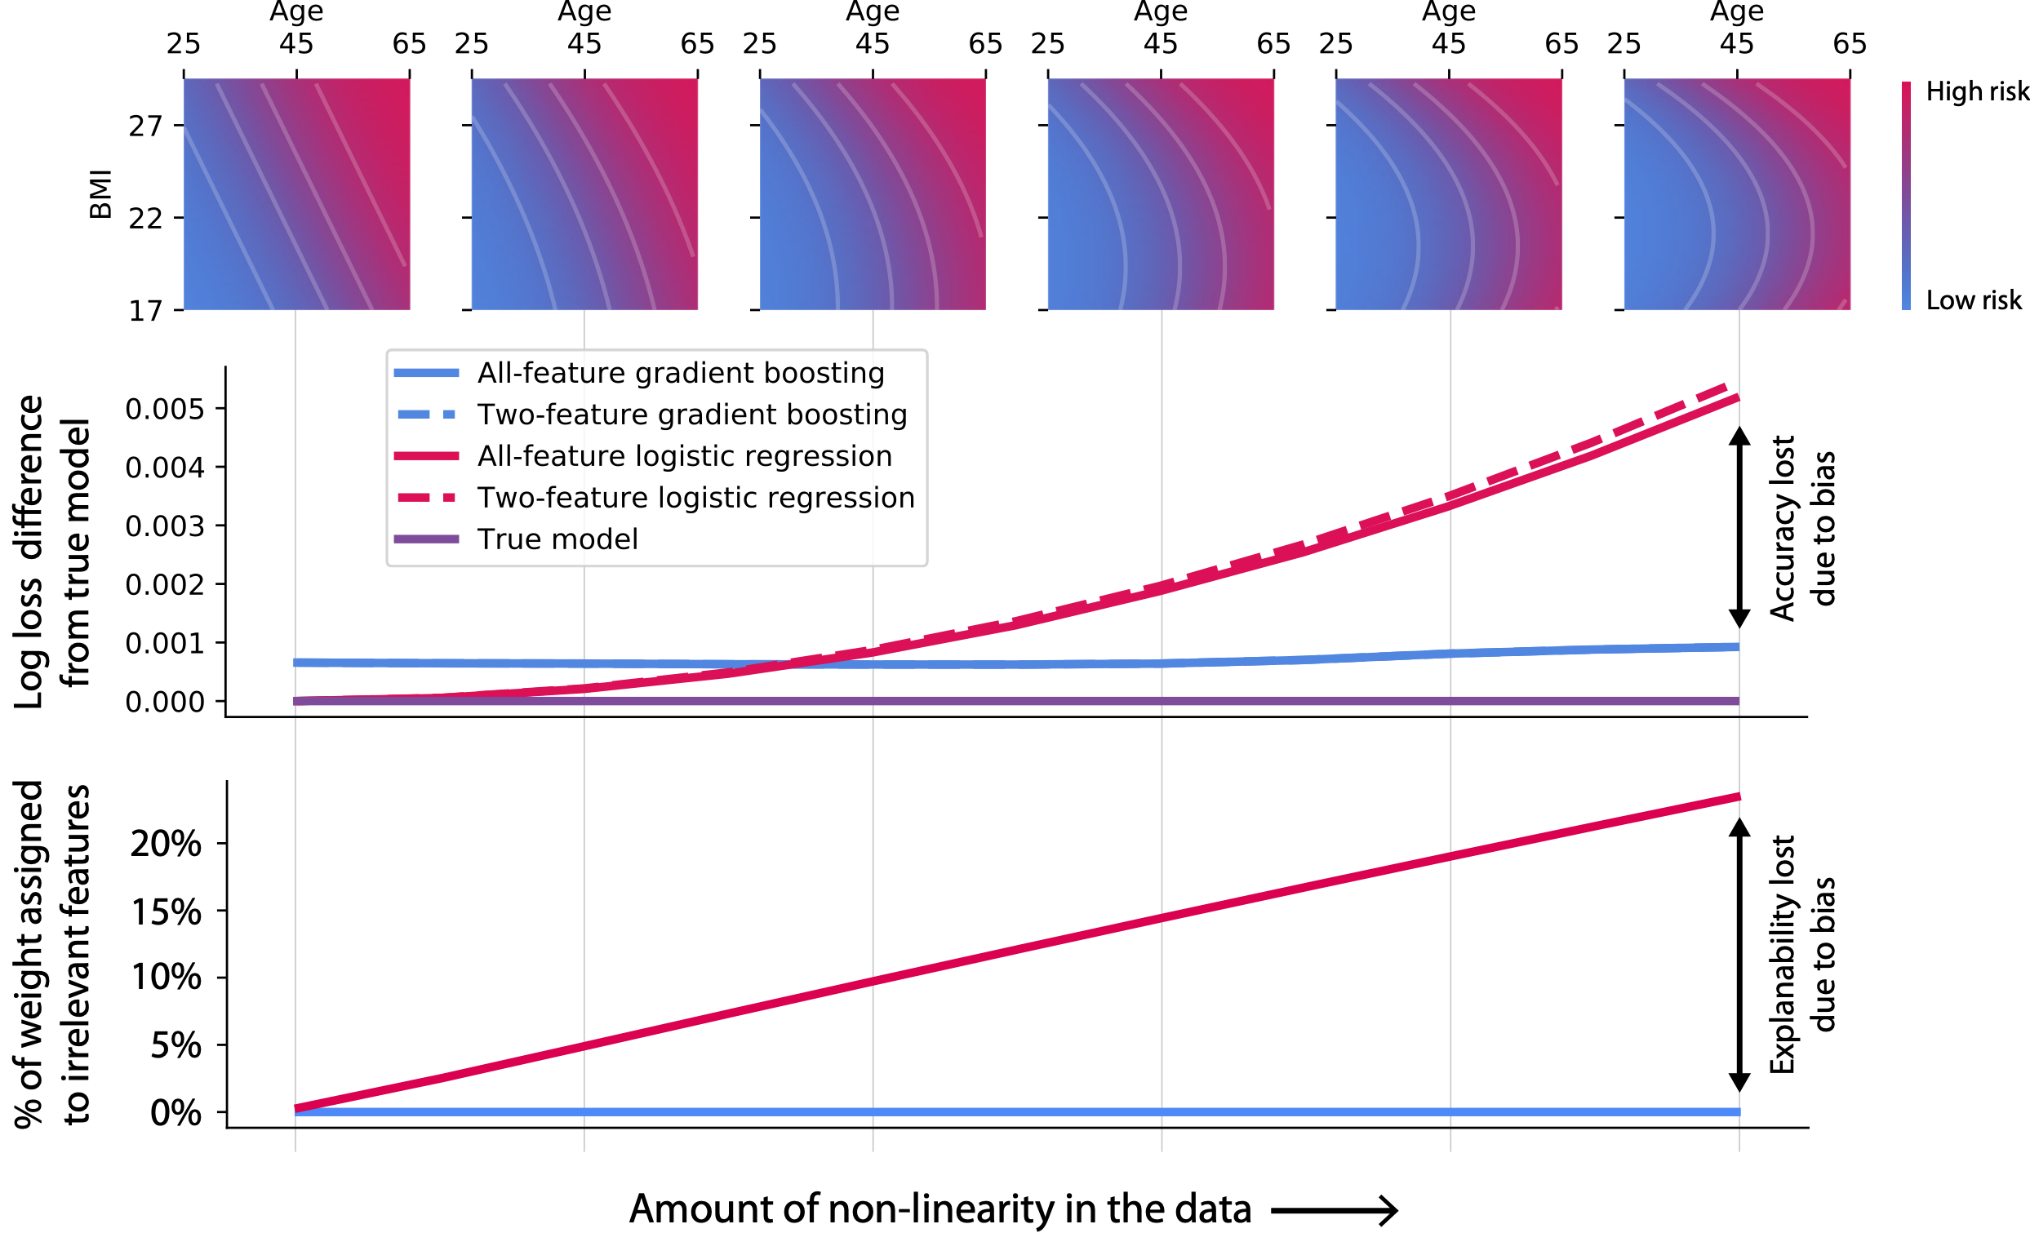

Slide 17
The dangers of global measures of feature importance

Slide 18
Mortality risk model
Notes:
Make title shorter

Slide 19
Mortality risk model
Notes:
Make title shorter

Slide 20
Mortality risk model
Notes:
Make title shorter

Slide 21
Mortality risk model
Notes:
Make title shorter

Slide 22
Mortality risk model
Notes:
Make title shorter

Slide 23
Mortality risk model
Notes:
Make title shorter

Slide 24
Reveal rare high-magnitude mortality effects
Mortality risk model
Conflates the
prevalence of an effect
with the
magnitude of an effect
Notes:
Make title shorter

Slide 25
Reveal rare high-magnitude mortality effects
Notes:
Make title shorter

Slide 26
Reveal rare high-magnitude mortality effects
Rare high magnitude effects
Notes:
Make title shorter

Slide 27
Reveal rare high-magnitude mortality effects
Not many ways to live longer…
Lots of ways to die young…
Notes:
Make title shorter

Slide 28
Dependence plots reveal the increased danger of early onset high blood pressure
Vertical dispersion is
driven by interaction effects
Notes:
Animate at the least

Slide 29
Uncovering subtle interaction effects
Notes:
Make title shorter

Slide 30
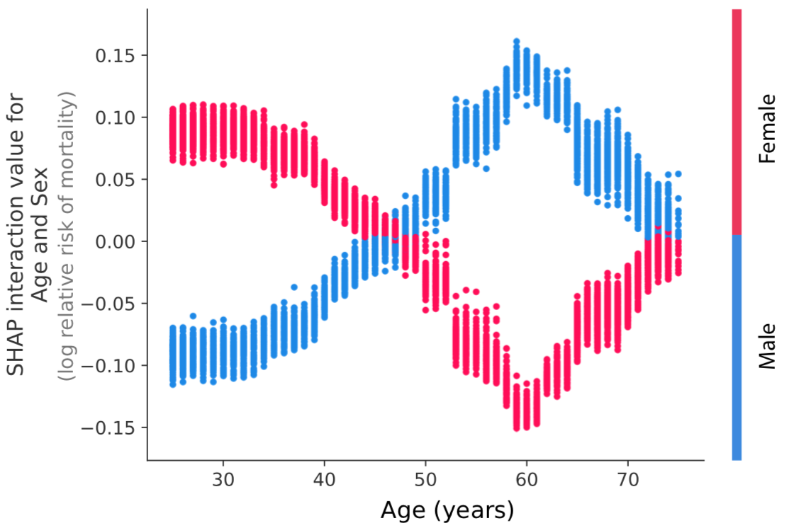
The varying risk of sex over a lifetime
Notes:
Make title shorter

Slide 31
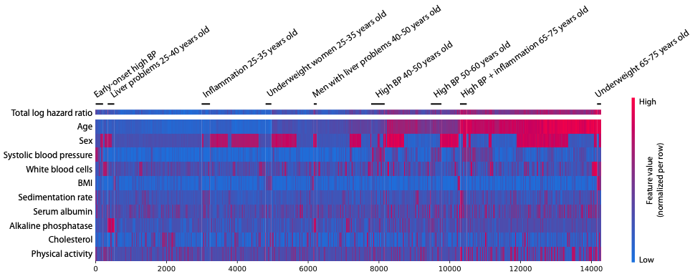
Using SHAP values as building blocks for interpretable ML: Supervised clustering
Notes:
Here is a result of visual explanations of a model designed to predict if a person makes >50K annually for 2000 people.
%% Red positive values push the probability higher, while negative blue values push the probability lower.
People are grouped based on the reasons that they have certain predicted incomes.

Slide 32
The value of explaining a model’s loss (not just the output)

Slide 33
Model monitoring
Time
Training performance
Test performance
Can you find where we introduced the bug?
Notes:
Make title shorter

Slide 34
Model monitoring
False
True
Now can you find where we introduced the bug?
Notes:
Focus more on for each

Slide 35
Model monitoring
False
True
Time
Transient electronic medical record
Time
Notes:
What is an EMR?

Slide 36
Model monitoring
False
True
Time
Gradual change in atrial fibrillation
ablation procedure durations
Time
Notes:
Make title shorter

Slide 37
The value of explaining fairness metrics

Slide 38
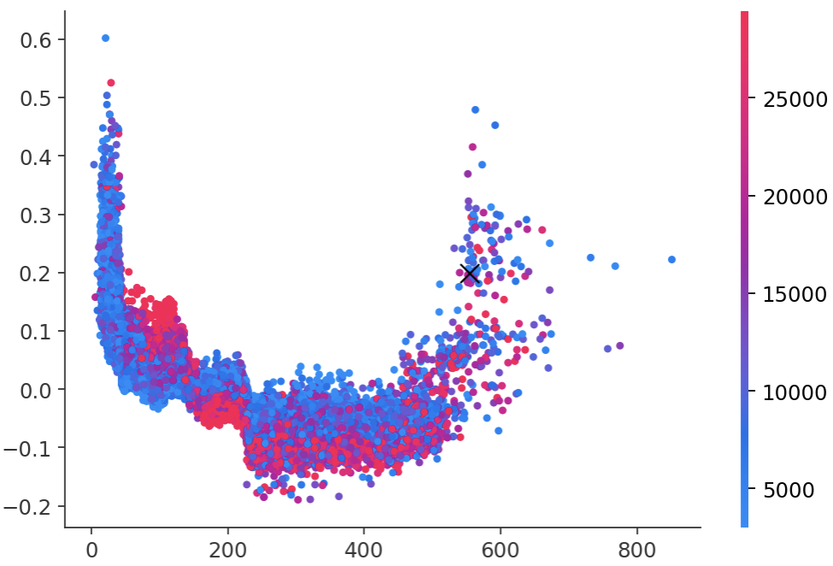
Identification of protected class discrimination
Higher-risk for retirement-age individuals
Impact on the risk of defaulting
(SHAP value)
Loan amount
Months since first credit card was opened

Slide 39
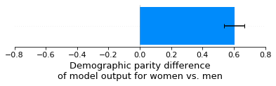
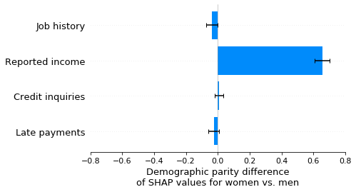

Slide 40
Accounting for the structure of your data in the game

Slide 41
”structure” of the data
x
Current/future directions
f(x)
Notes:
We'll start with a simple motivational example. This is John, a typical bank customer. Like many consumers today, when he applies for a loan, information about him is sent through a predictive model XX.
This model is designed to calculate the risk that John will have repayment problems, XX which, unfortunately for John, is 55%. And because his risk is high, the bank declines his loan application XX.
A natural first question John has XX is “Why?” The bank XX also want to know why, because these are key business decisions. But unfortunately for the data scientist that built this model XX, she used a complex model and so these questions are hard to answer XX …. XX

Slide 42
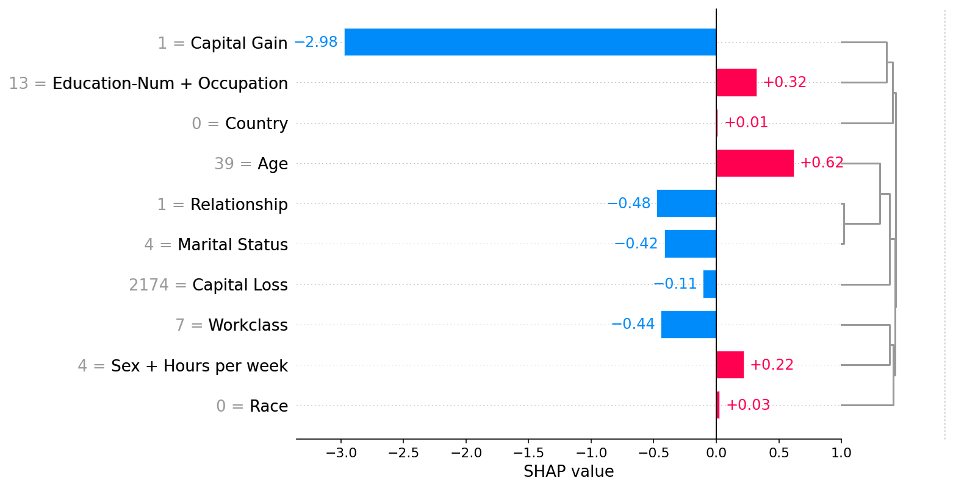
Showing redundant features

Slide 43
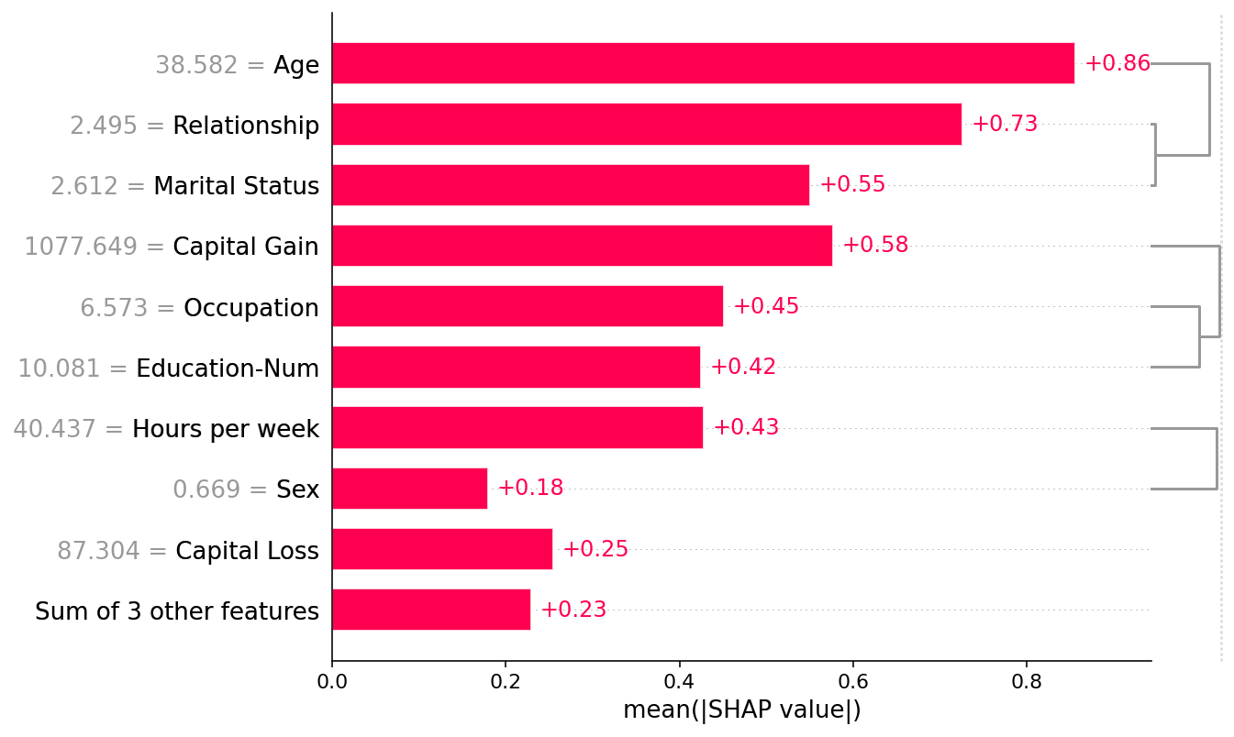
Showing redundant features

Slide 44
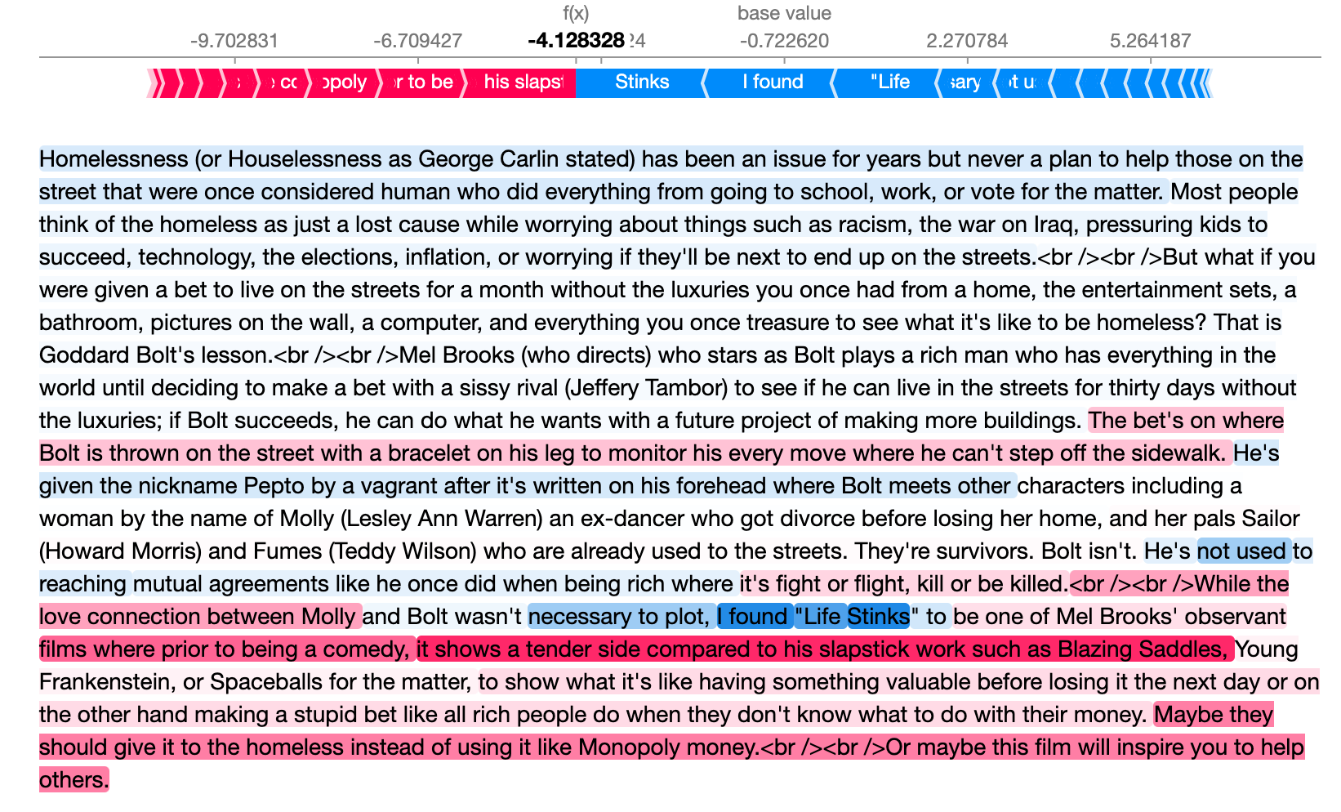
Showing redundant features

Slide 45

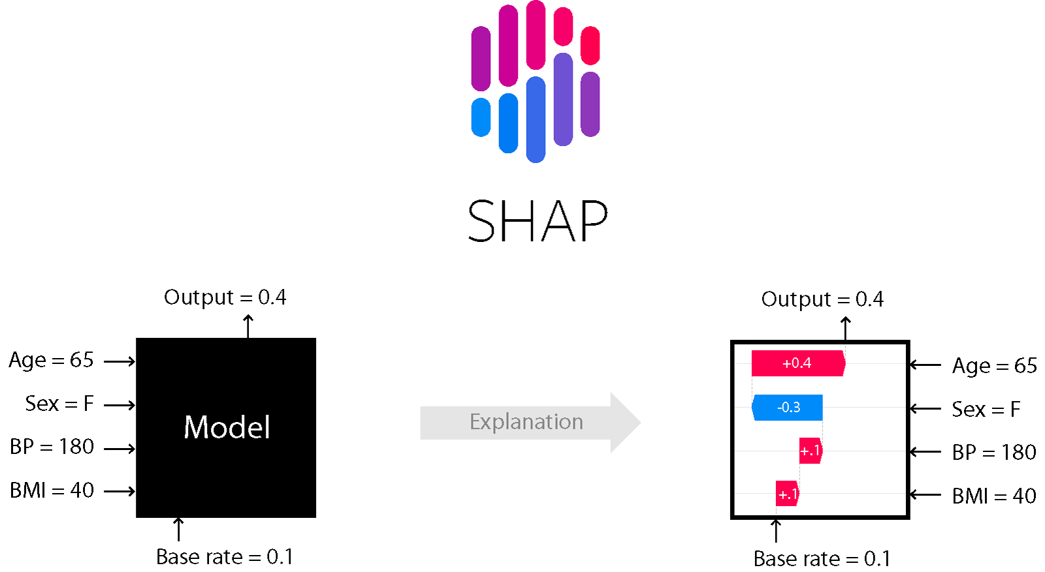
Thanks!
github.com/slundberg/shap

